Slide 1


Hargobind S. Gill
Saturday, July 20th, 2024

Slide 2

Outline
Executive Summary
Introduction
Methodology
Results
Conclusion
Appendix

Slide 3
Executive Summary
Summary of all results
Success Rate Over Time: Significant Improvement over Defined Periods
Success Rate by Launch Site: The highest success rate of all launch sites was KSC LC-39A.
Success Rate by Orbit: The highest success rates observed were amongst ES-L1, SSO, HEO, & GEO.
Predictive Algorithms: The DecisionTreeClassifier was most accuracte in the prediction of landing outcomes.
Payload Analysis: It is seen that heavier payloads have higher failure rates, though success of which improves over time.
Summary of methodologies
Data Collection via APIs & Web Scraping
Data Wrangling Techniques
Exploratory Data Analysis with SQL & Visualization Tools
Interactive Visual Analytics w/ Folium
Interactive Dashboard w/ Plotly Dash
Machine Learning Predictions (KNN, Decision Trees, SVM)

Slide 4
Introduction
Project background and context
SpaceX Falcon 9 Rocket Launches => $62mm
Other Providers Cost => $165mm
The nearly $100mm in savings is due to SpaceX’s proprietary rocket reuse technology post-first stage launch.
Problems you want to find answers
Will SpaceX’s Falcon 9 Rocket land successfully?
What is the historical success rate of these past launches?
What metrics may be utilized in prediction of the probability of success for future launches?

Slide 5

Section 1

Slide 6
Methodology
Executive Summary
Data collection methodology:
Collection was constructed through SpaceX API endpoints and webscraping via Wikipedia
Perform data wrangling
Performed ETL of SpaceX data, respectively tuning appropriate records & dropping nulls
Perform exploratory data analysis (EDA) using visualization and SQL
Illustrative analysis presented through Pie, Scatter, Bar, and other charts
Perform interactive visual analytics using Folium and Plotly Dash
Perform predictive analysis using classification models
Building, tuning, and evaluating classification models utilizing Ensemble Tree Methods and Regression Analyses

Slide 7
Data Collection
Data Collection:
HTTP Requests pivoting with SpaceX API Endpoints, to extract the respective raw data
Utilized tabular data from webscraping applications on the Wikipedia.org site
Webscraping
Wikipedia
Data
ETL Processes
(Extract, Transform, Load) +
Populate Pandas DataFrame
OPTIONAL
Export Cleaned Data
to .csv file format

Slide 8
Data Collection – SpaceX API
Initiate Connection w/HTML Requests to SpaceX API
ETL Processes
Pre-loading JSON file’s data into Pandas DataFrame
Data Cleaning and Handling
Dropping empty columns and ensuring validity
OPTIONAL
Export respective cleaned data to .csv file format
GitHub Link

Slide 9
Data Collection - Scraping
Initiate Connection w/ HTML Requests + Construct
BeautifulSoup Object
Determine Matching Tables + Identify Columns for Extraction
Append Existing Data and Convert End Result to Pandas DataFrame
OPTIONAL
Export respective cleaned data to .csv file format
GitHub Link

Slide 10
Data Wrangling
Describe how data were processed
Utilizing Exploratory Data Analysis (EDA) toolkits in order to readily identify pattern sequences in data structures.
Import/Load Data into Pandas DataFrame + Clean for Null or Missing Values
Identification of Labels + Boolean Operators to Define Success / Failure
OPTIONAL
Export Cleaned Data
to .csv file format
GitHub Link

Slide 11
EDA with Data Visualization
The following charts were plotted in accordance with the Jupyter Assignment
Flight Number v. Outcomes
Flight Number v. Launch Site
Payload v. Launch Site
Payload v. Orbit
Orbit v. Outcome
Flight Number v. Orbit
As well as, the Year-on-Year Success Rate v. Orbit
- These charts were provisioned such as to analyze dependency arguments, impacts of variables on one another, as well as trend determination on a YoY basis.
GitHub Link

Slide 12
EDA with SQL
Individuals Steps Involved:
Firstly, one is surveying the database in order to draw conclusions upon any patterns that exist.
(i) Loading + Pre-Processing of Data
(ii) DataFrame Manipulation – Display of entries with names beginning in ‘CCA’
(iii) Performing Arithmetic Operations Upon Specified Date Bounds (Counts + Rank b/w certain years)
(iv) Illustrating Payload Carry on part of weightage >=4,000 kg and <=6,000 kg (Booster Versions List)
(v) Formulating Counts of Successful and Failed Operations
(vi) Decree booster versions which passed this requisite marking (such as Year = 2015)
(vii) Displaying outcome distributions between the Year and Date Bounds
GitHub Link

Slide 13
Build an Interactive Map with Folium
Folium Map Overview & Contextual Framework:
Determination of geographical markedness within data such as to note pattern recognition b/w launch sites
Launch Site Testing and Folium Markers were illustrated as such:
Principally constructing a holistic map encompassing all launch sites within the United States,
Pooling Successful and Failed Operations on part of Launches between the aforementioned sites
Displaying Distance Markers to Identify Localized Structures for Launch Sites and Proximity to Landmarks
GitHub Link

Slide 14
Build a Dashboard with Plotly Dash
An Overview of Plotly Dash:
Selection for Launch Sites
Relational Percentage Pie Chart – Launch Sites
Correlation Scatterplots – Payload & Success v. Launch Site
In basic terms, this is to provide an illustrative and interactive framework within which one can analyze the mass of the payload, success of the launch, and launch site control features as it interrelates to these categories and between launch sites.
GitHub Link

Slide 15
Predictive Analysis (Classification)
Steps Involved:
Preprocessing of Data and Loading into Pandas DataFrame for manipulation purposes (ETL)
StandardScaler Application on X and Conversion of Y (Target Variable = “Class”) to Numpy Array
Splitting of Training and Testing Data using Train/Test Split, then utilizing GridSearchCV in order to optimize hyperparameters for model performance
Algorithms utilized in this case include:
Logistic Regression, SVC/SVM, Decision Tree (Classifier), K-Neighbors (Classifier)
Preprocessing of Data + Loading into Pandas DataFrame
Standardization of Data + Conversion of “Class” (Target Var) to Numpy Array
Train/Test Split
GridSearchCV
Comparison of Model Perf.
GitHub Link

Slide 16
Results
Exploratory data analysis results
Interactive analytics demo in screenshots
Predictive analysis results

Slide 17

Section 2

Slide 18
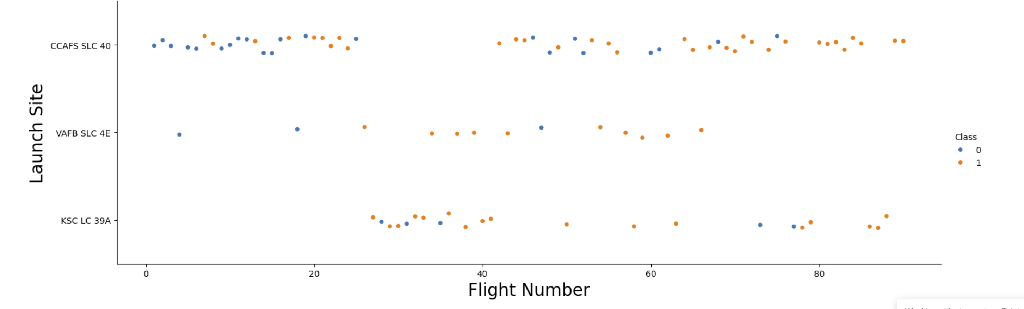
Flight Number vs. Launch Site
Sites originally struggled with failures, positive checks strengthened over time
VAFB SLC 4E had the best performance in terms of percentage Class Successes
Earlier flights principally showcased signs of weakness and failure in Class determination

Slide 19
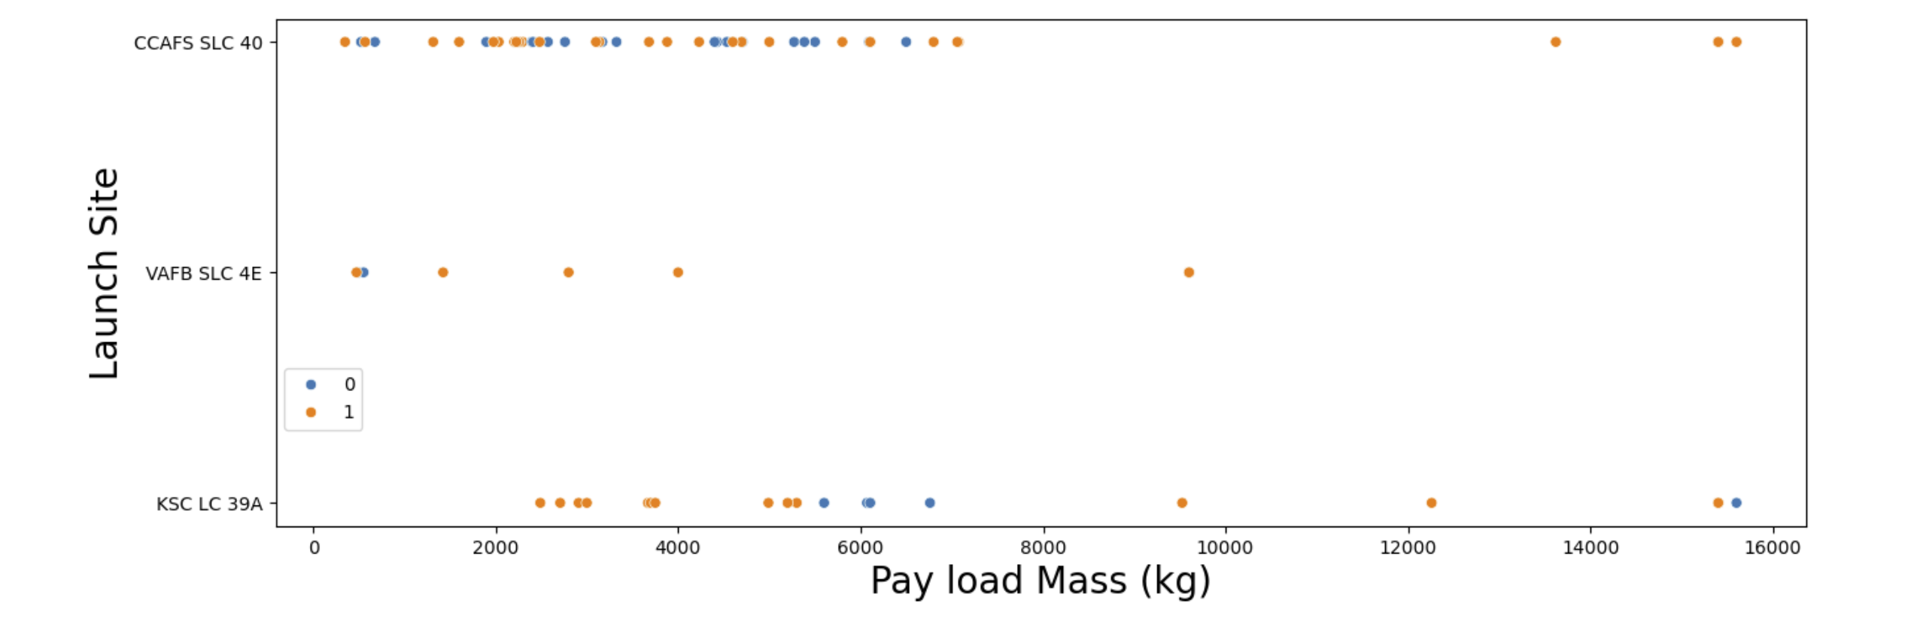
Payload vs. Launch Site
There exists a success breaking point for all launch sites above 7,000 kg, where most launches were 1 in the classification system.
It is seen that launches with higher Payload Mass (in kg) had higher chances of success than the overall distribution.

Slide 20
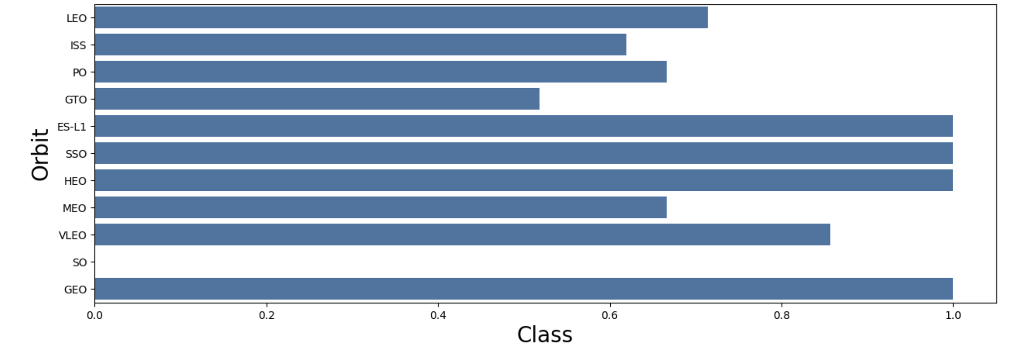
Success Rate vs. Orbit Type
Orbits such as ES-L1, SSO, HEO, and GEO consistently performed the best amongst the rest, with success rates near or at 1.
SO, having only one launch, could not display any tangible data to be studied.

Slide 21
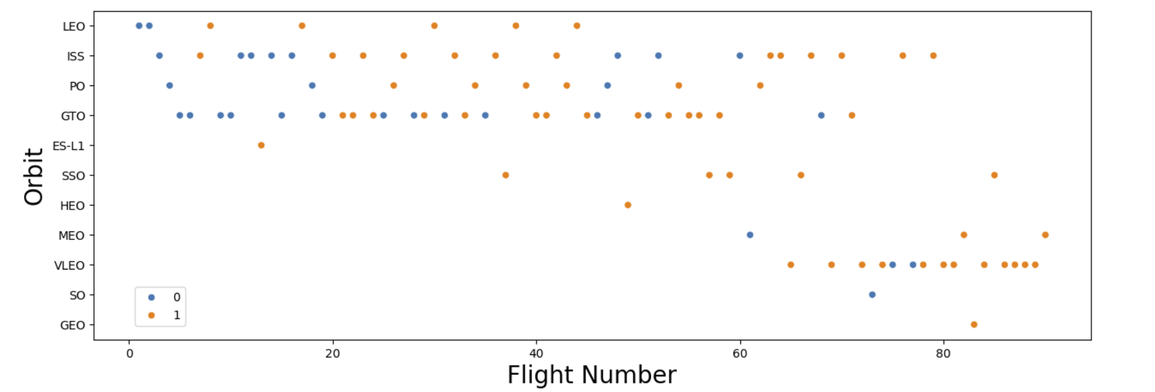
Flight Number vs. Orbit Type
There exists a wide diversity amongst orbits and flight numbers, with some participating across the broadness of the spectrum and some only at the upper echelons of the flight numbers.
As flight numbers increase, generally, the success rate also increases (which can generally be seen as FL > 60).

Slide 22
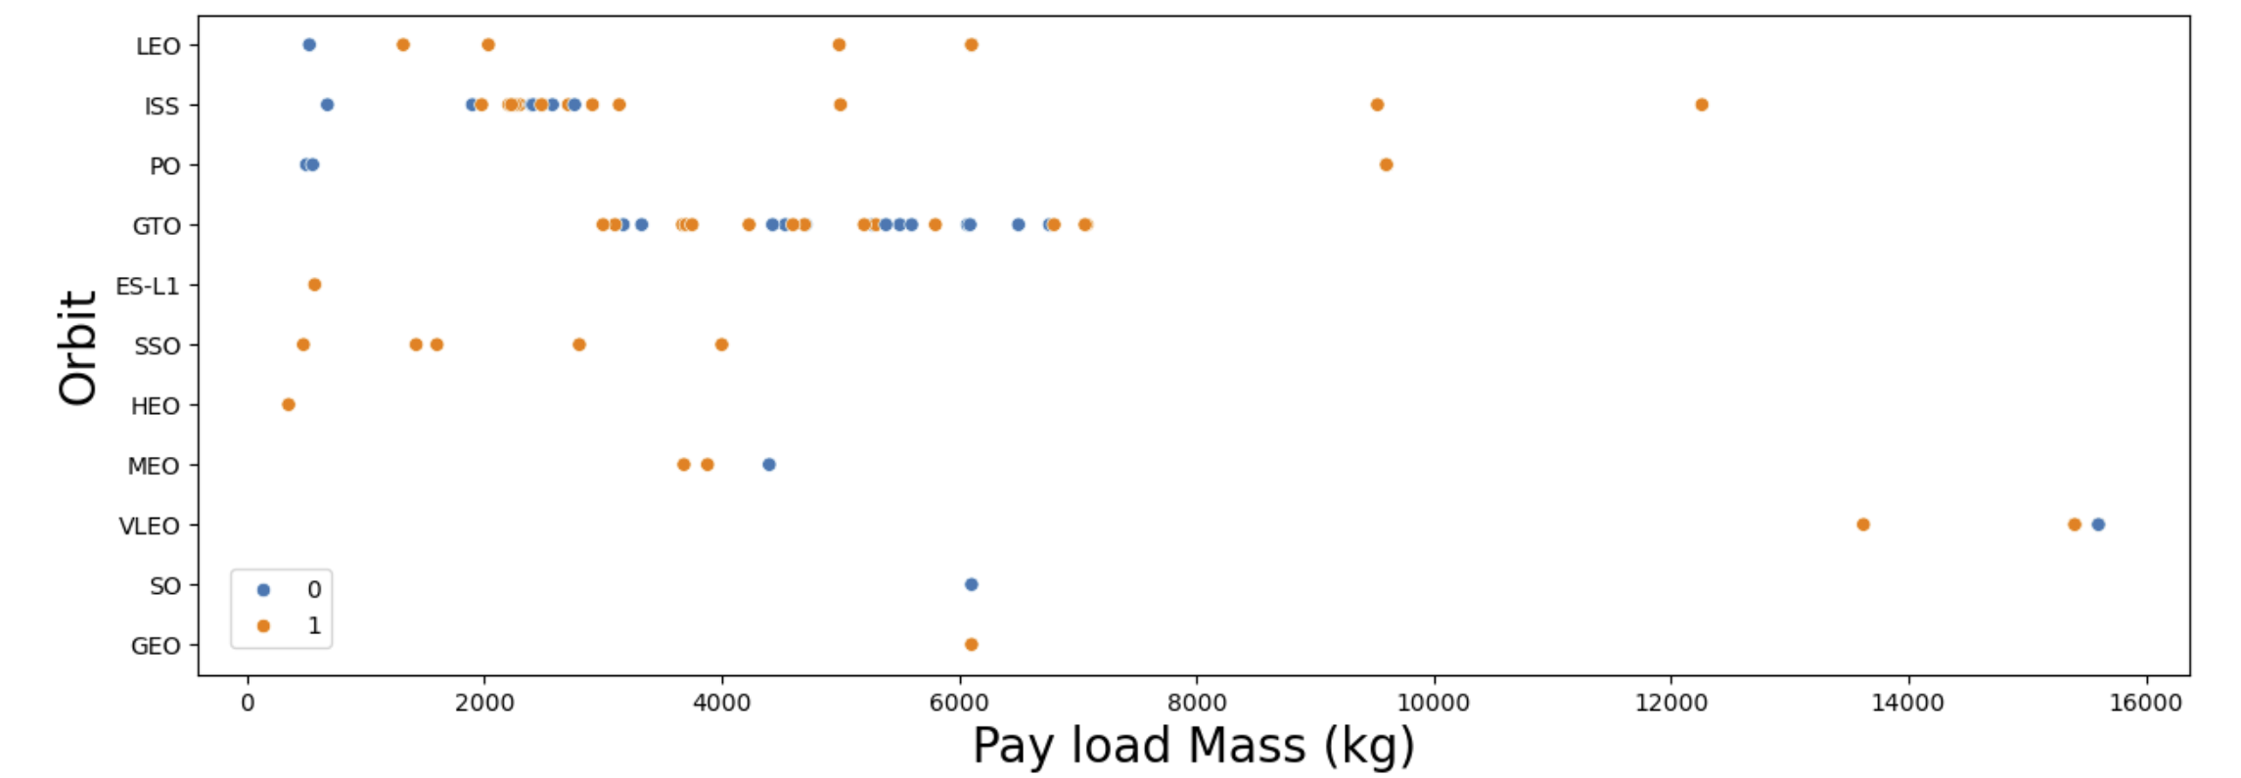
Payload vs. Orbit Type
The most successful orbits typically have tighter ranges for payload masses such as SSO, ES-L1, HEO, and GEO.
As such, orbits with tighter ranges showcase better success rates than wider ones.

Slide 23
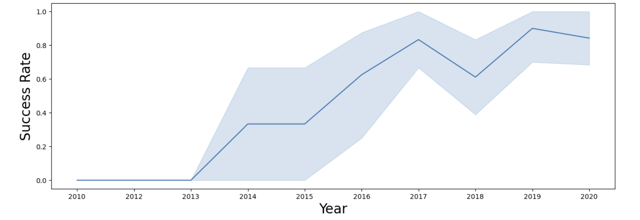
Launch Success Yearly Trend
Success rate has generally increased year on year, with only a significant downturn present between 2017 and 2018.
This perhaps indicates technological improvements and better testing/safety measures in place to ensure successful launches.

Slide 24
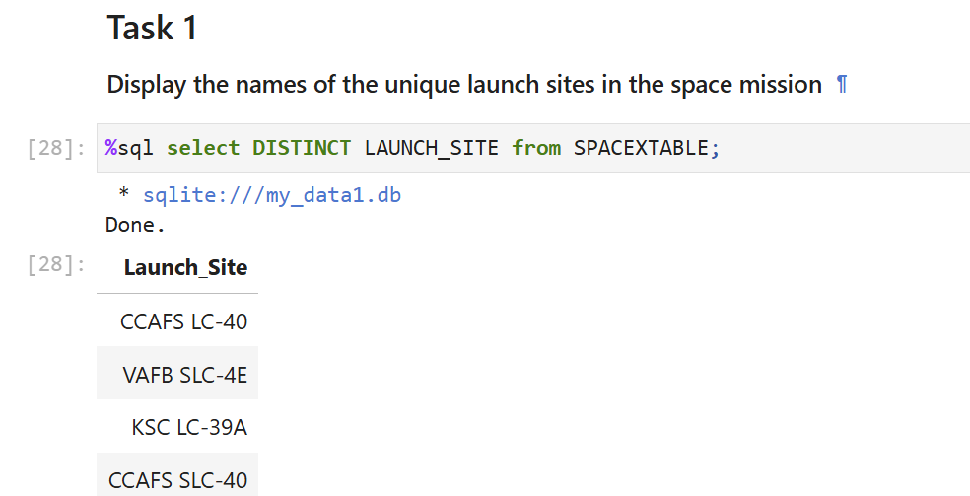
All Launch Site Names
Utilizing the DISTINCT operator to locate unique launch sites.

Slide 25
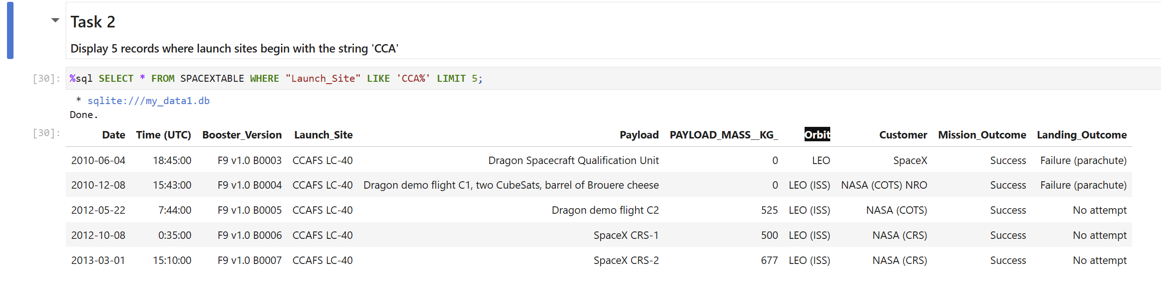
Launch Site Names Begin with 'CCA'
Simply utilizing the LIMIT statement to display 5 records, where launch sites start with ‘CCA’.

Slide 26
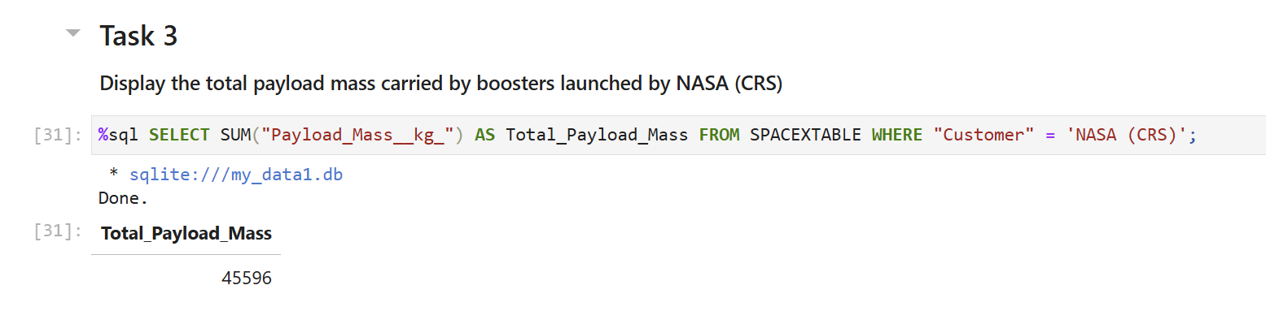
Total Payload Mass
Utilizing the built-in SUM function to display the total payload mass carried by boosters launched by NASA.

Slide 27
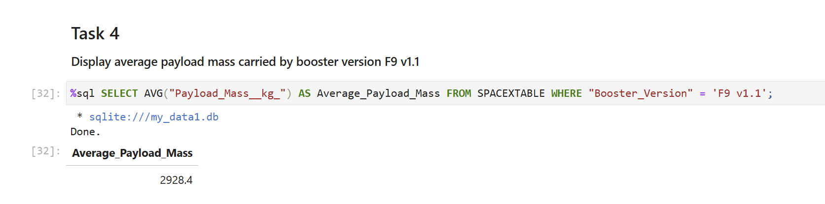
Average Payload Mass by F9 v1.1
Using the AVG function in SQL to illustrate the average payload mass carried by booster version F9 v1.1

Slide 28
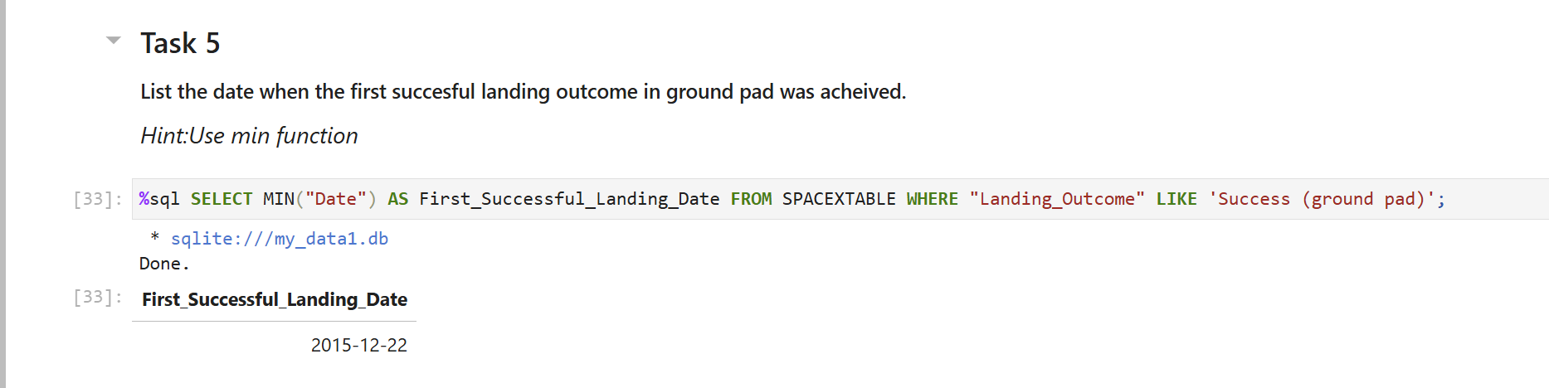
First Successful Ground Landing Date
Constructing a SQL statement around the MIN function and LIKE operator to narrow down data findings

Slide 29
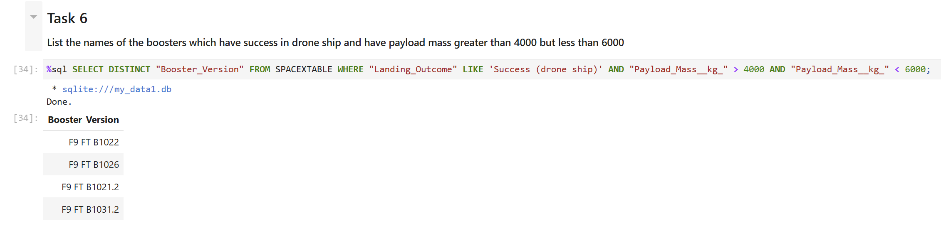
Successful Drone Ship Landing with Payload between 4000 and 6000
Proffering the AND operator to initiate logical statements for purposes of filtration and calculation

Slide 30
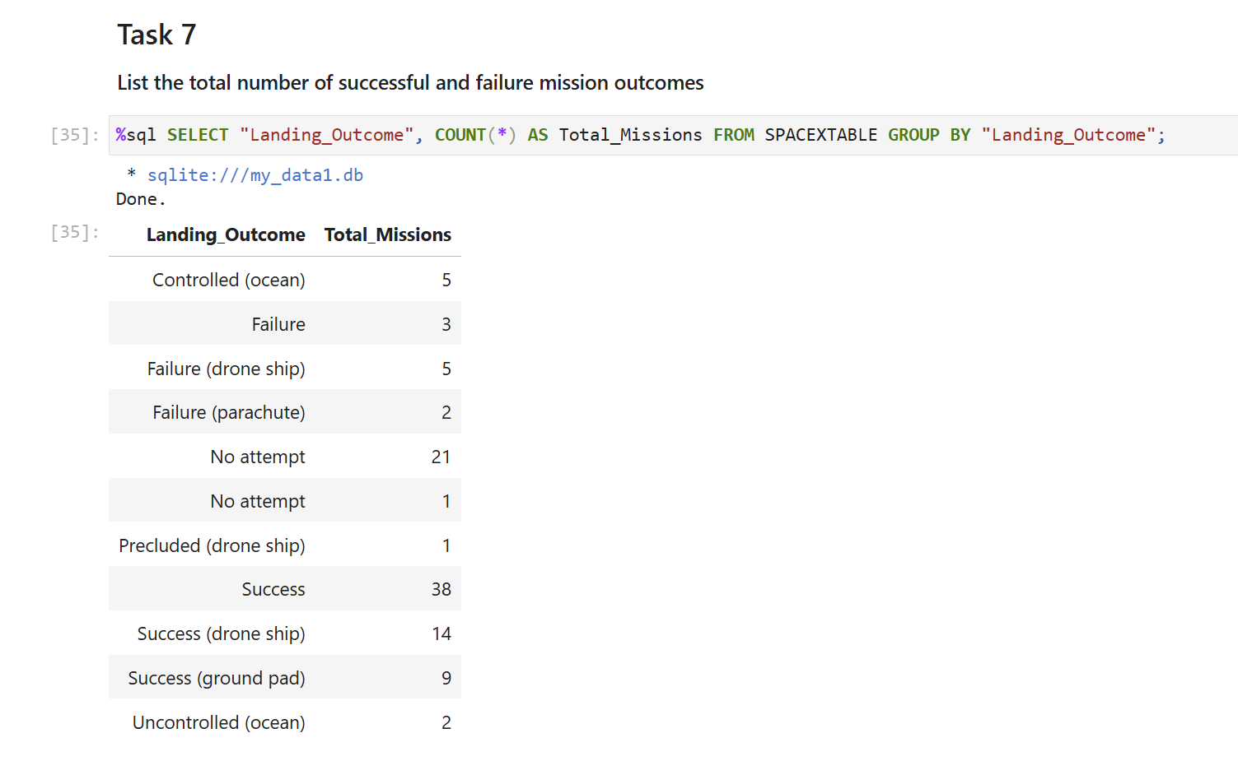
Total Number of Successful and Failure Mission Outcomes
Developing the statement through the GROUP BY operator, decreeing counts by outcomes

Slide 31
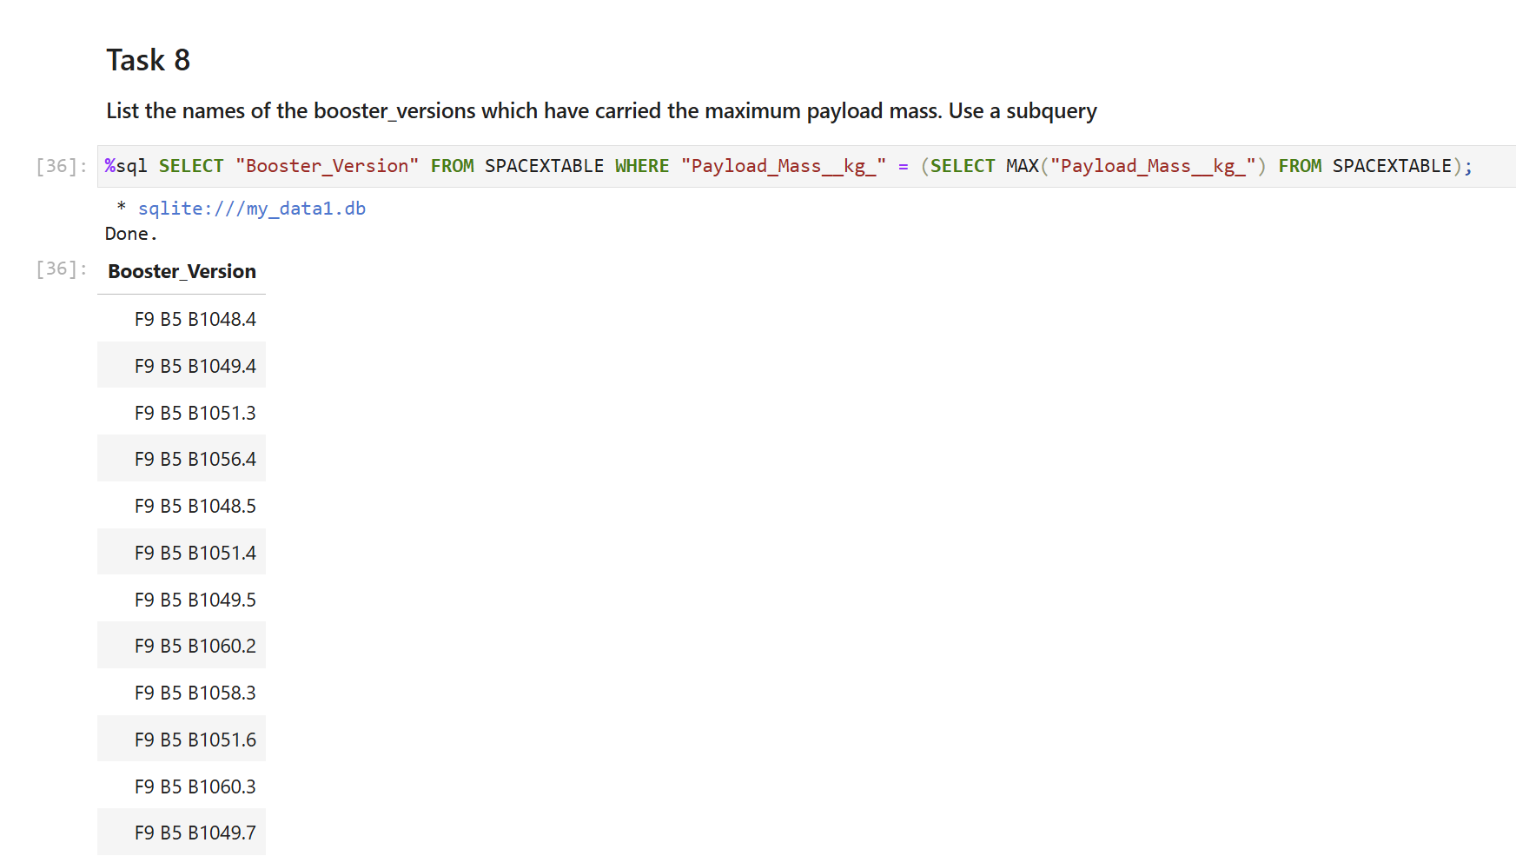
Boosters Carried Maximum Payload
Decreeing a subquery to further hone in requirements satisfied for max payload mass

Slide 32
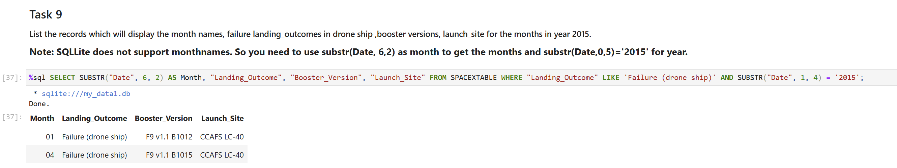
2015 Launch Records
Constructing the statement utilizing the SUBSTR function which aids in filtration through date initialization

Slide 33
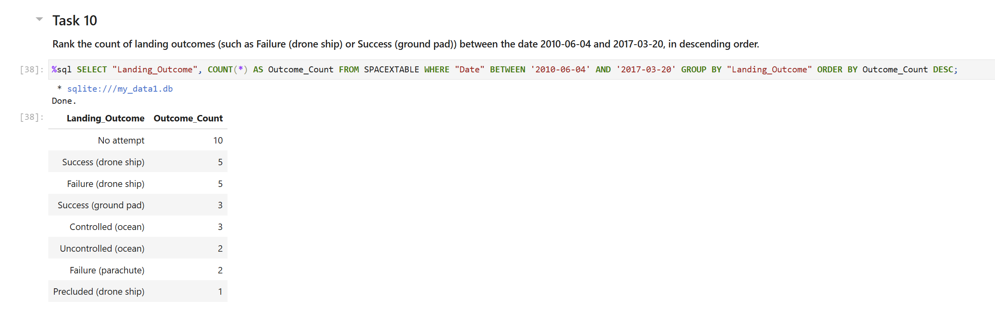
Rank Landing Outcomes Between 2010-06-04 and 2017-03-20
Lastly ranking landing outcomes through the ORDER BY clause to showcase counts in a desc. order

Slide 34

Section 3

Slide 35
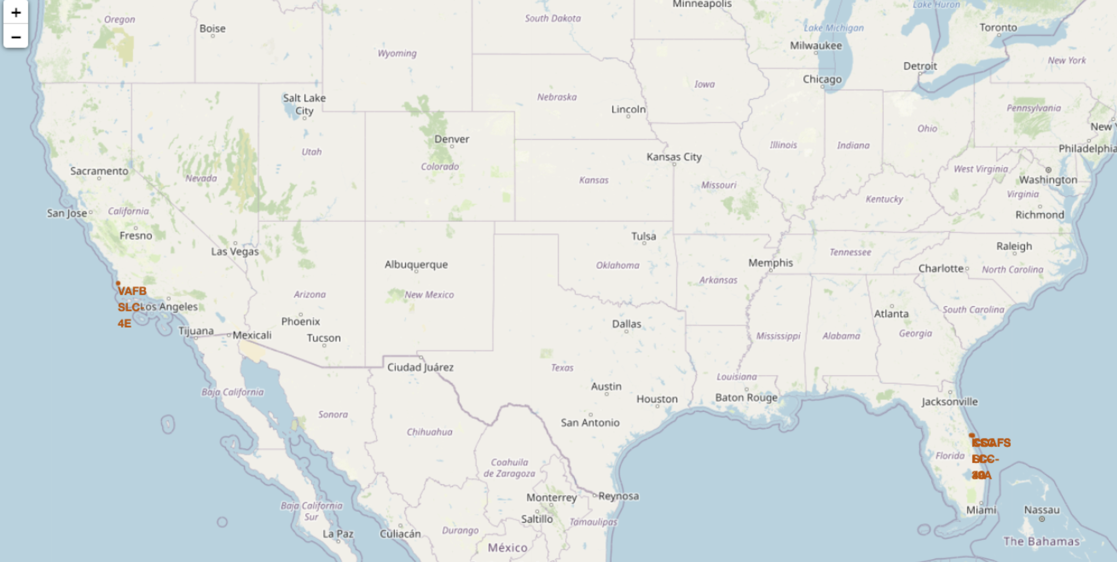
Nationwide Map of Launch Sites
The major launch sites are located in California and Florida.

Slide 36
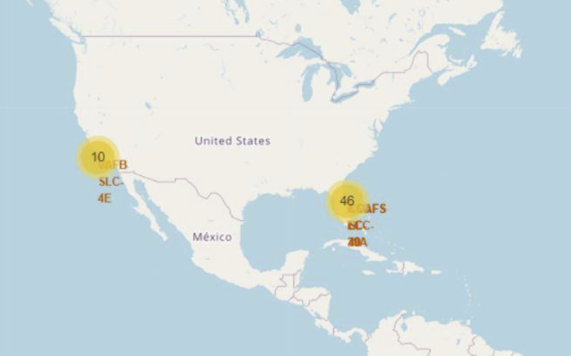
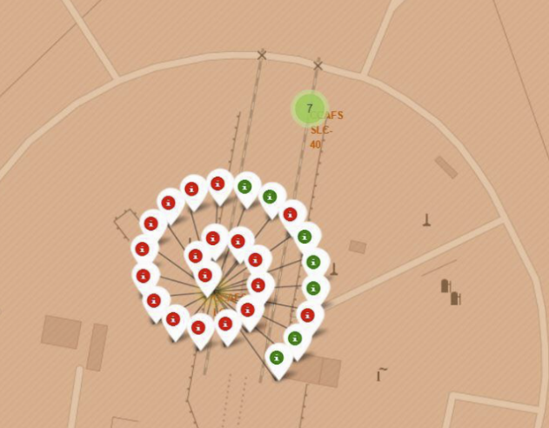
A Closer Zoom-In on Launch Site Success Rates
There exist more launch sites present within Florida than California.
In so, Folium markers were added to showcase the success and failure rates at launch sites.

Slide 37
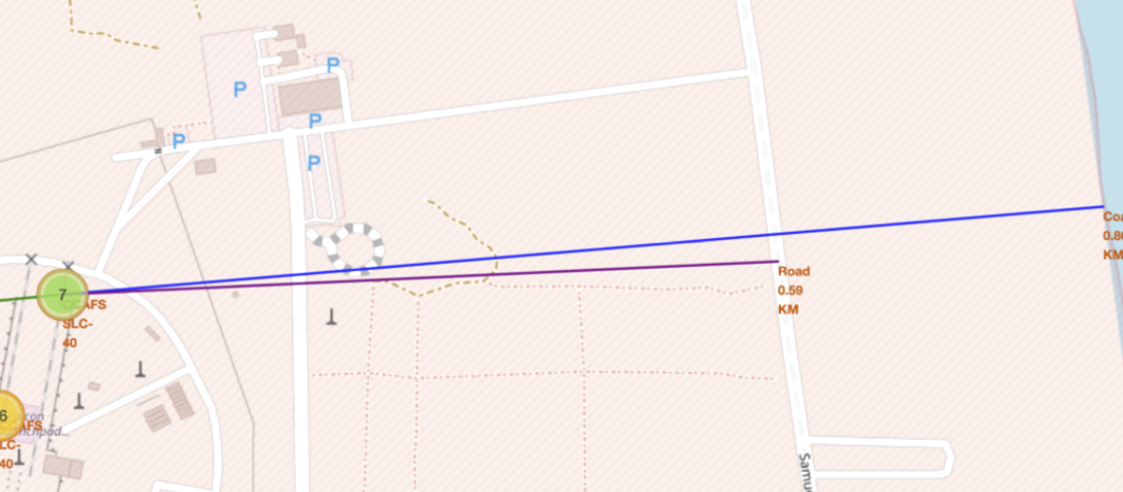
Notable Locations and their Distances Computed
This Folium line constructs the distance (straight-line) between landmarks and the launch sites.
A couple keynote examples of this include the image above, where the road is 0.6km away and the coast is 0.9 km afar.

Slide 38

Section 4

Slide 39
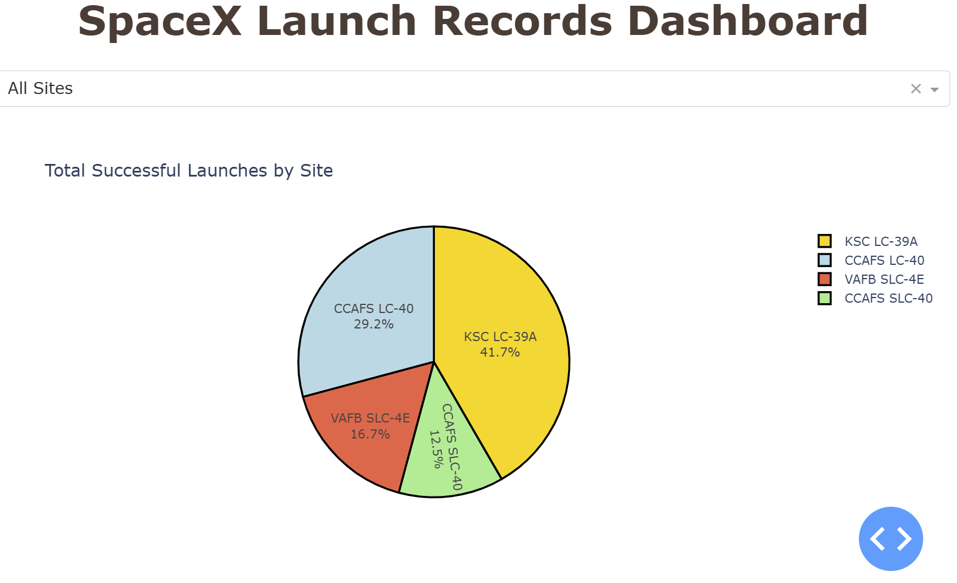
Pie Chart of Success Rates by Launch Site (SpaceX)
KSC LC-39 had the highest percentage of successful launches amongst all the other sites.
CCAFS SLC-40 had the least successful, at nearly a quarter of the percentage of KSC LC-39.

Slide 40
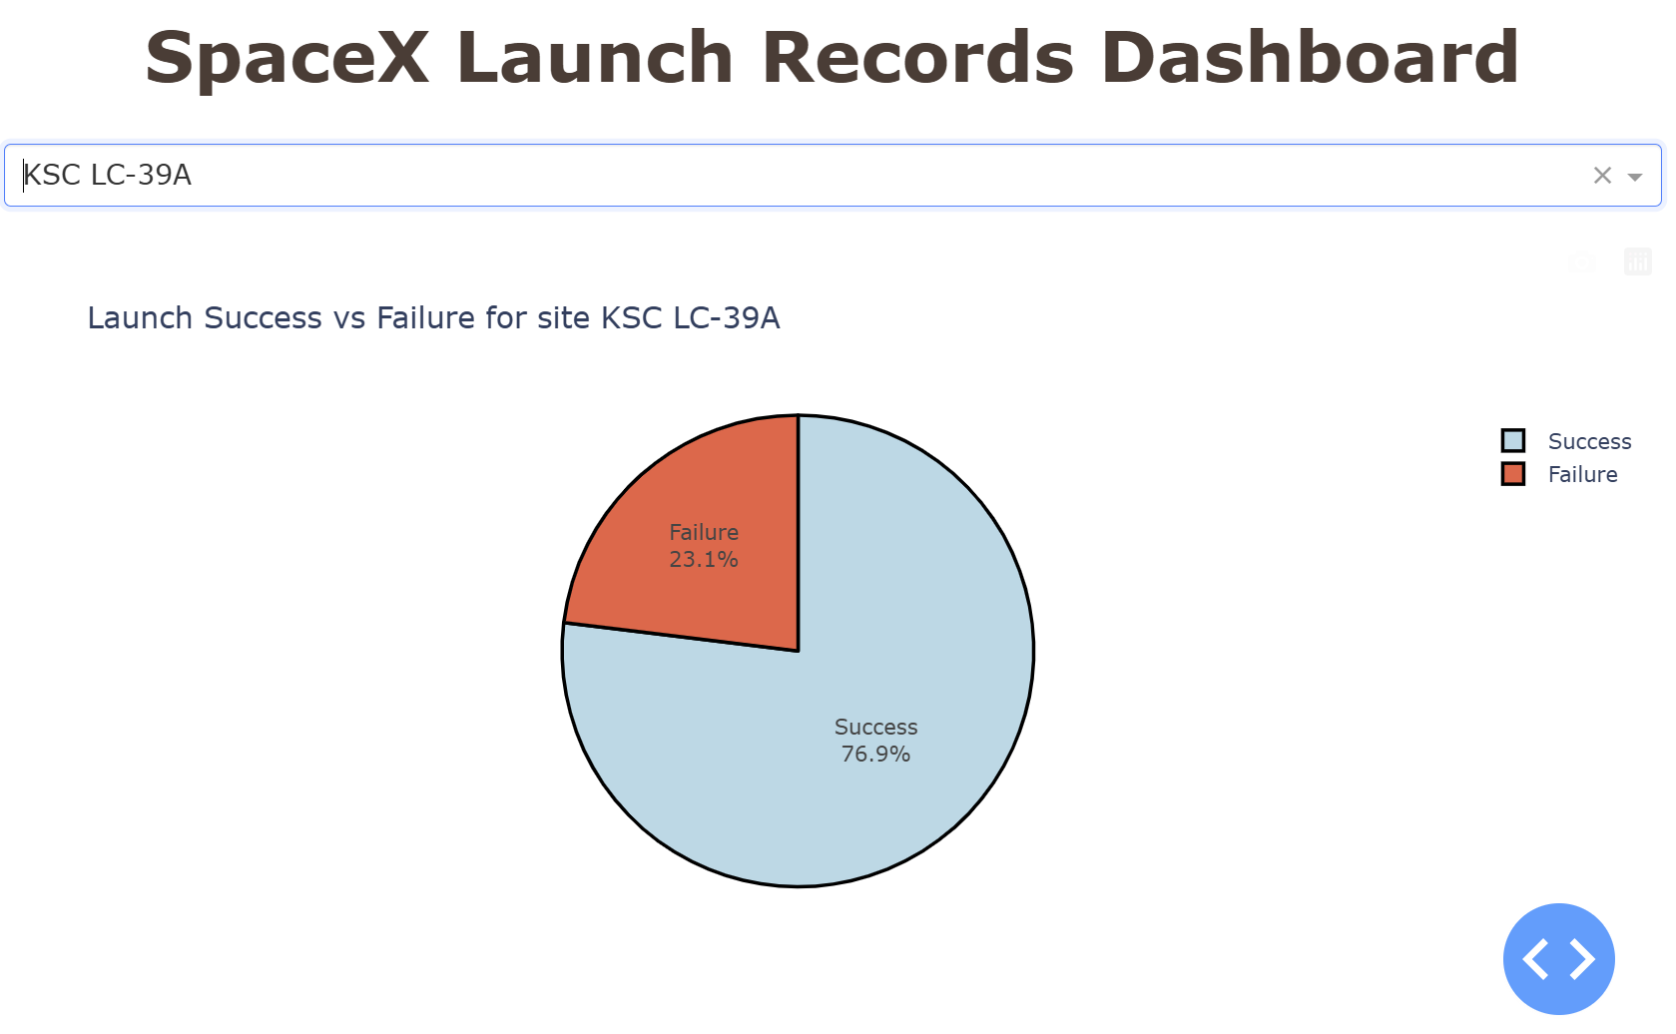
Pie Chart of Success v. Failure Rates for site KSC LC-39A
This graph serves as an illustration of the most successful launch site’s success v. failure rate.
KSC LC-39 had a 3-1 ratio of success to failure, indicating a very strong domain for launches.

Slide 41
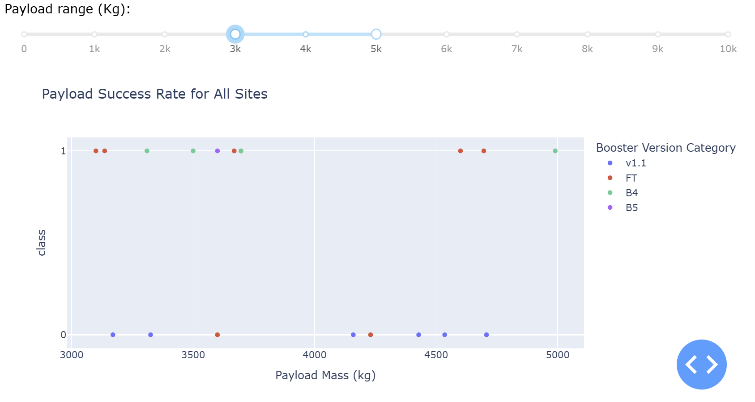
Payload Success Rate Scatterplot for All Sites
The FT and B4 boosters performed the best across all major versions and had the highest success rates evdent by the collection of 1s situated at the top of the binary chart.
Having the bounds set for payload masses between 3,000 - 5,000 kg, it can be seen that v1.1 performs under par.

Slide 42

Section 5

Slide 43
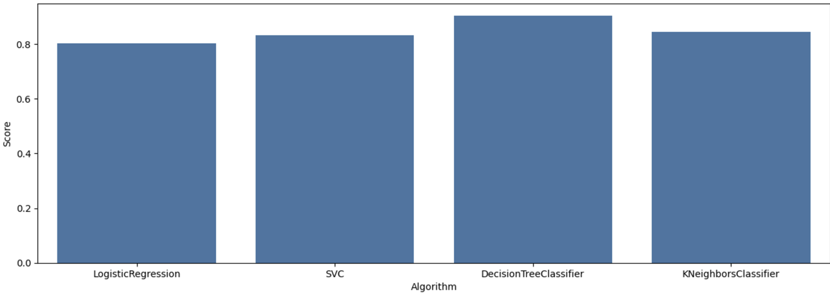
Classification Accuracy
The DecisionTreeClassifier had the highest predictive accuracy as is compared with all the other algorithms, and is the only one closest to performing at nearly 90% accuracy.
The other algorithms follow in accuracy order of KNeighborsClassifier, SVC, and LogisticRegression in last.

Slide 44
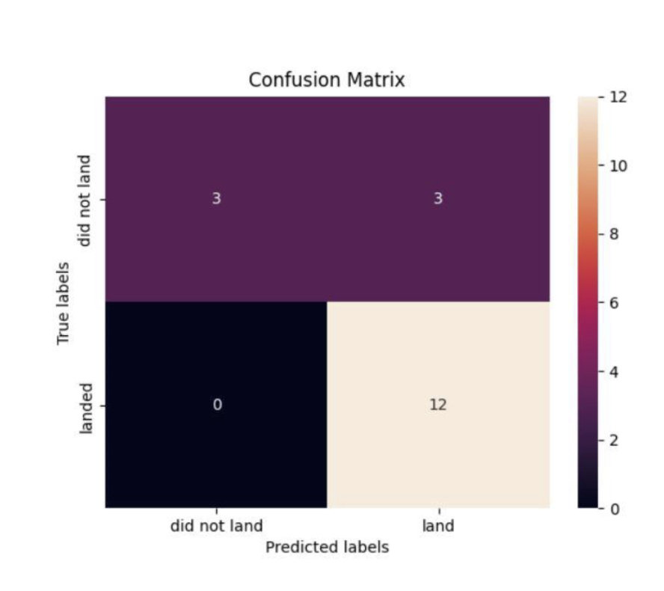
Confusion Matrix
This image represents the Confusion Matrix for the DecisionTreeClassifier.
Overall it can be seen that 15/18 predictions were true, though false positives are evidently an issue here, skewing perception of the model.

Slide 45
Summary of all results
Success Rate Over Time: Significant Improvement over Defined Periods
Success Rate by Launch Site: The highest success rate of all launch sites was KSC LC-39A.
Success Rate by Orbit: The highest success rates observed were amongst ES-L1, SSO, HEO, & GEO.
Predictive Algorithms: The DecisionTreeClassifier was most accuracte in the prediction of landing outcomes.
Payload Analysis: It is seen that heavier payloads have higher failure rates, though success of which improves over time.
Conclusions

Slide 46
Appendix
Include any relevant assets like Python code snippets, SQL queries, charts, Notebook outputs, or data sets that you may have created during this project

Slide 47


